Slide 1
Basic Business Statistics
11th Edition
Chapter 9
Fundamentals of Hypothesis Testing: One-Sample Tests
Basic Business Statistics, 11e © 2009 Prentice-Hall, Inc.
Chap 9-<number>

Slide 2
Learning Objectives
In this chapter, you learn:
The basic principles of hypothesis testing
How to use hypothesis testing to test a mean or proportion
The assumptions of each hypothesis-testing procedure, how to evaluate them, and the consequences if they are seriously violated
How to avoid the pitfalls involved in hypothesis testing
The ethical issues involved in hypothesis testing
Basic Business Statistics, 11e © 2009 Prentice-Hall, Inc..
Chap 9-<number>

Slide 3

What is a Hypothesis?
A hypothesis is a claim
(assumption) about a
population parameter:
  population mean
  population proportion
Example: The mean monthly cell phone bill in this city is μ = $42
Example: The proportion of adults in this city with cell phones is π = 0.68
Basic Business Statistics, 11e © 2009 Prentice-Hall, Inc..
Chap 9-<number>

Slide 4
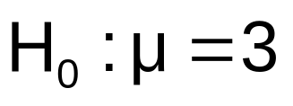

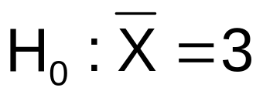
The Null Hypothesis, H₀
States the claim or assertion to be tested
  Example: The average number of TV sets in U.S. Homes is equal to three ( )
Is always about a population parameter, not about a sample statistic
Basic Business Statistics, 11e © 2009 Prentice-Hall, Inc..
Chap 9-<number>

Slide 5

The Null Hypothesis, H₀
(continued)
Begin with the assumption that the null hypothesis is true
  Similar to the notion of innocent until
  proven guilty
Refers to the status quo or historical value
Always contains “=” , “≤” or “≥” sign
May or may not be rejected
Basic Business Statistics, 11e © 2009 Prentice-Hall, Inc..
Chap 9-<number>

Slide 6
The Alternative Hypothesis, H₁
Is the opposite of the null hypothesis
  e.g., The average number of TV sets in U.S. homes is not equal to 3 ( H₁: μ ≠ 3 )
Challenges the status quo
Never contains the “=” , “≤” or “≥” sign
May or may not be proven
Is generally the hypothesis that the researcher is trying to prove
Basic Business Statistics, 11e © 2009 Prentice-Hall, Inc..
Chap 9-<number>

Slide 7
The Hypothesis Testing Process
Claim: The population mean age is 50.
  H₀: μ = 50, H₁: μ ≠ 50
Sample the population and find sample mean.
Population
Sample
Basic Business Statistics, 11e © 2009 Prentice-Hall, Inc..
Chap 9-<number>

Slide 8
The Hypothesis Testing Process
(continued)
Suppose the sample mean age was X = 20.
This is significantly lower than the claimed mean population age of 50.
If the null hypothesis were true, the probability of getting such a different sample mean would be very small, so you reject the null hypothesis .
In other words, getting a sample mean of 20 is so unlikely if the population mean was 50, you conclude that the population mean must not be 50.
Basic Business Statistics, 11e © 2009 Prentice-Hall, Inc..
Chap 9-<number>

Slide 9
The Hypothesis Testing Process
(continued)
Sampling Distribution of X
X
20
μ = 50
If H₀ is true
... then you reject the null hypothesis that μ = 50.
If it is unlikely that you would get a sample mean of this value ...
... When in fact this were
the population mean…
Basic Business Statistics, 11e © 2009 Prentice-Hall, Inc..
Chap 9-<number>

Slide 10
The Test Statistic and
Critical Values
If the sample mean is close to the assumed population mean, the null hypothesis is not rejected.
If the sample mean is far from the assumed population mean, the null hypothesis is rejected.
How far is “far enough” to reject H₀?
The critical value of a test statistic creates a “line in the sand” for decision making -- it answers the question of how far is far enough.
Basic Business Statistics, 11e © 2009 Prentice-Hall, Inc..
Chap 9-<number>

Slide 11
The Test Statistic and
Critical Values
Sampling Distribution of the test statistic
Region of Rejection
Region of Rejection
Region of
Non-Rejection
Critical Values
“Too Far Away” From Mean of Sampling Distribution
Basic Business Statistics, 11e © 2009 Prentice-Hall, Inc..
Chap 9-<number>

Slide 12
Possible Errors in Hypothesis Test Decision Making
Type I Error
  Reject a true null hypothesis
  Considered a serious type of error
  The probability of a Type I Error is α
    Called level of significance of the test
    Set by researcher in advance
Type II Error
  Failure to reject false null hypothesis
  The probability of a Type II Error is β
Basic Business Statistics, 11e © 2009 Prentice-Hall, Inc..
Chap 9-<number>

Slide 13
Possible Errors in Hypothesis Test Decision Making
(continued)
Possible Hypothesis Test Outcomes
 | Actual Situation
Decision | H₀ True | H₀ False
Do Not Reject H₀ | No Error Probability 1 - α | Type II Error Probability β
Reject H₀ | Type I Error Probability α | No Error Probability 1 - β
Basic Business Statistics, 11e © 2009 Prentice-Hall, Inc..
Chap 9-<number>

Slide 14
Possible Errors in Hypothesis Test Decision Making
(continued)
The confidence coefficient (1-α) is the probability of not rejecting H₀ when it is true.
The confidence level of a hypothesis test is (1-α)*100%.
The power of a statistical test (1-β) is the probability of rejecting H₀ when it is false.
Basic Business Statistics, 11e © 2009 Prentice-Hall, Inc..
Chap 9-<number>

Slide 15
Type I & II Error Relationship
Type I and Type II errors cannot happen at
the same time
  A Type I error can only occur if H₀ is true
  A Type II error can only occur if H₀ is false
If Type I error probability ( α ) , then
Type II error probability ( β )
Basic Business Statistics, 11e © 2009 Prentice-Hall, Inc..
Chap 9-<number>

Slide 16
Factors Affecting Type II Error
All else equal,
  β when the difference between hypothesized parameter and its true value
  β when α
  β when σ
  β when n
Basic Business Statistics, 11e © 2009 Prentice-Hall, Inc..
Chap 9-<number>

Slide 17
Level of Significance and the Rejection Region
H₀: μ = 3 H₁: μ ≠ 3
Level of significance =
α
α
α
/2
/2
0
Critical values
Rejection Region
This is a two-tail test because there is a rejection region in both tails
Basic Business Statistics, 11e © 2009 Prentice-Hall, Inc..
Chap 9-<number>

Slide 18
Hypothesis Tests for the Mean
Hypothesis
Tests for μ
σ Known
σ Unknown
(Z test)
(t test)
Basic Business Statistics, 11e © 2009 Prentice-Hall, Inc..
Chap 9-<number>

Slide 19
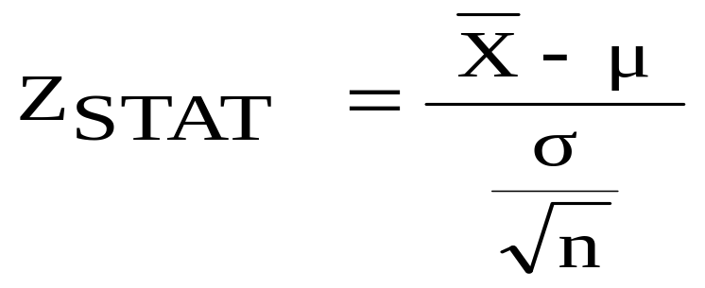
Z Test of Hypothesis for the Mean (σ Known)
Convert sample statistic ( ) to a Z_{STAT} test statistic
X
Hypothesis
Tests for μ
σ Known
σ Known
σ Unknown
σ Unknown
(Z test)
(t test)
The test statistic is:
Basic Business Statistics, 11e © 2009 Prentice-Hall, Inc..
Chap 9-<number>

Slide 20

Critical Value
Approach to Testing
For a two-tail test for the mean, σ known:
Convert sample statistic ( ) to test statistic (Z_{STAT})
Determine the critical Z values for a specified
level of significance α from a table or computer
Decision Rule: If the test statistic falls in the rejection region, reject H₀ ; otherwise do not reject H₀
Basic Business Statistics, 11e © 2009 Prentice-Hall, Inc..
Chap 9-<number>

Slide 21
Two-Tail Tests
H₀: μ = 3 H₁: μ ≠ 3
There are two cutoff values (critical values), defining the regions of rejection
α/2
α/2
3
X
Reject H₀
Do not reject H₀
Reject H₀
-Z_{α/2}
+Z_{α/2}
Z
0
Lower critical value
Upper critical value
Basic Business Statistics, 11e © 2009 Prentice-Hall, Inc..
Chap 9-<number>

Slide 22
6 Steps in
Hypothesis Testing
State the null hypothesis, H₀ and the alternative hypothesis, H₁
Choose the level of significance, α, and the sample size, n
Determine the appropriate test statistic and sampling distribution
Determine the critical values that divide the rejection and nonrejection regions
Basic Business Statistics, 11e © 2009 Prentice-Hall, Inc..
Chap 9-<number>

Slide 23
6 Steps in
Hypothesis Testing
(continued)
Collect data and compute the value of the test statistic
Make the statistical decision and state the managerial conclusion. If the test statistic falls into the nonrejection region, do not reject the null hypothesis H₀. If the test statistic falls into the rejection region, reject the null hypothesis. Express the managerial conclusion in the context of the problem
Basic Business Statistics, 11e © 2009 Prentice-Hall, Inc..
Chap 9-<number>

Slide 24
Hypothesis Testing Example
Test the claim that the true mean # of TV sets in US homes is equal to 3.
(Assume σ = 0.8)
1. State the appropriate null and alternative
hypotheses
  H₀: μ = 3 H₁: μ ≠ 3 (This is a two-tail test)
2. Specify the desired level of significance and the sample size
  Suppose that α = 0.05 and n = 100 are chosen for this test
Basic Business Statistics, 11e © 2009 Prentice-Hall, Inc..
Chap 9-<number>

Slide 25
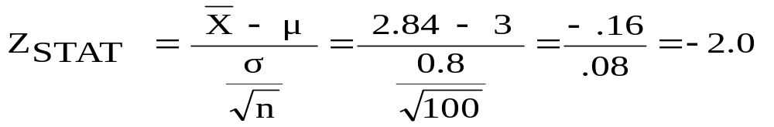
Hypothesis Testing Example
(continued)
3. Determine the appropriate technique
  σ is assumed known so this is a Z test.
4. Determine the critical values
  For α = 0.05 the critical Z values are ±1.96
5. Collect the data and compute the test statistic
  Suppose the sample results are
  n = 100, X = 2.84 (σ = 0.8 is assumed known)
  So the test statistic is:
Basic Business Statistics, 11e © 2009 Prentice-Hall, Inc..
Chap 9-<number>

Slide 26
Hypothesis Testing Example
(continued)
6. Is the test statistic in the rejection region?
α/2 = 0.025
α/2 = 0.025
Reject H₀ if Z_{STAT} < -1.96 or Z_{STAT} > 1.96; otherwise do not reject H₀
Reject H₀
Do not reject H₀
Reject H₀
-Z_{α/2} = -1.96
0
+Z_{α/2} = +1.96
Here, Z_{STAT} = -2.0 < -1.96, so the test statistic is in the rejection region
Basic Business Statistics, 11e © 2009 Prentice-Hall, Inc..
Chap 9-<number>

Slide 27
Hypothesis Testing Example
(continued)
6 (continued). Reach a decision and interpret the result
α = 0.05/2
α = 0.05/2
Reject H₀
Do not reject H₀
Reject H₀
-Z_{α/2} = -1.96
0
+Z_{α/2}= +1.96
-2.0
Since Z_{STAT} = -2.0 < -1.96, reject the null hypothesis and conclude there is sufficient evidence that the mean number of TVs in US homes is not equal to 3
Basic Business Statistics, 11e © 2009 Prentice-Hall, Inc..
Chap 9-<number>

Slide 28
p-Value Approach to Testing
p-value: Probability of obtaining a test statistic equal to or more extreme than the observed sample value given H₀ is true
  The p-value is also called the observed level of significance
  It is the smallest value of α for which H₀ can be rejected
Basic Business Statistics, 11e © 2009 Prentice-Hall, Inc..
Chap 9-<number>

Slide 29
p-Value Approach to Testing:
Interpreting the p-value
Compare the p-value with α
  If p-value < α , reject H₀
  If p-value ≥ α , do not reject H₀
Remember
  If the p-value is low then H₀ must go
Basic Business Statistics, 11e © 2009 Prentice-Hall, Inc..
Chap 9-<number>

Slide 30
The 5 Step p-value approach to
Hypothesis Testing
State the null hypothesis, H₀ and the alternative hypothesis, H₁
Choose the level of significance, α, and the sample size, n
Determine the appropriate test statistic and sampling distribution
Collect data and compute the value of the test statistic and the p-value
Make the statistical decision and state the managerial conclusion. If the p-value is < α then reject H₀, otherwise do not reject H₀. State the managerial conclusion in the context of the problem
Basic Business Statistics, 11e © 2009 Prentice-Hall, Inc..
Chap 9-<number>

Slide 31
p-value Hypothesis Testing Example
Test the claim that the true mean # of TV sets in US homes is equal to 3.
(Assume σ = 0.8)
1. State the appropriate null and alternative
hypotheses
  H₀: μ = 3 H₁: μ ≠ 3 (This is a two-tail test)
2. Specify the desired level of significance and the sample size
  Suppose that α = 0.05 and n = 100 are chosen for this test
Basic Business Statistics, 11e © 2009 Prentice-Hall, Inc..
Chap 9-<number>

Slide 32
p-value Hypothesis Testing Example
(continued)
3. Determine the appropriate technique
  σ is assumed known so this is a Z test.
4. Collect the data, compute the test statistic and the p-value
  Suppose the sample results are
  n = 100, X = 2.84 (σ = 0.8 is assumed known)
  So the test statistic is:
Basic Business Statistics, 11e © 2009 Prentice-Hall, Inc..
Chap 9-<number>

Slide 33
p-Value Hypothesis Testing Example:
Calculating the p-value
4. (continued) Calculate the p-value.
  How likely is it to get a Z_{STAT} of -2 (or something further from the mean (0), in either direction) if H₀ is true?
P(Z < -2.0) = 0.0228
P(Z > 2.0) = 0.0228
0
Z
-2.0
2.0
p-value = 0.0228 + 0.0228 = 0.0456
Basic Business Statistics, 11e © 2009 Prentice-Hall, Inc..
Chap 9-<number>

Slide 34
p-value Hypothesis Testing Example
(continued)
5. Is the p-value < α?
  Since p-value = 0.0456 < α = 0.05 Reject H₀
5. (continued) State the managerial conclusion in the context of the situation.
  There is sufficient evidence to conclude the average number of TVs in US homes is not equal to 3.
Basic Business Statistics, 11e © 2009 Prentice-Hall, Inc..
Chap 9-<number>

Slide 35
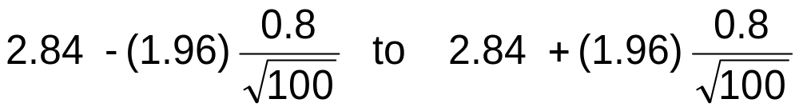
Connection Between Two Tail Tests and Confidence Intervals
For X = 2.84, σ = 0.8 and n = 100, the 95% confidence interval is:
2.6832 ≤ μ ≤ 2.9968
Since this interval does not contain the hypothesized mean (3.0), we reject the null hypothesis at α = 0.05
Basic Business Statistics, 11e © 2009 Prentice-Hall, Inc..

Slide 36
Do You Ever Truly Know σ?
Probably not!
In virtually all real world business situations, σ is not known.
If there is a situation where σ is known then µ is also known (since to calculate σ you need to know µ.)
If you truly know µ there would be no need to gather a sample to estimate it.
Basic Business Statistics, 11e © 2009 Prentice-Hall, Inc..
Chap 9-<number>

Slide 37
Hypothesis Testing: σ Unknown
If the population standard deviation is unknown, you instead use the sample standard deviation S.
Because of this change, you use the t distribution instead of the Z distribution to test the null hypothesis about the mean.
When using the t distribution you must assume the population you are sampling from follows a normal distribution.
All other steps, concepts, and conclusions are the same.
Basic Business Statistics, 11e © 2009 Prentice-Hall, Inc..
Chap 9-<number>

Slide 38
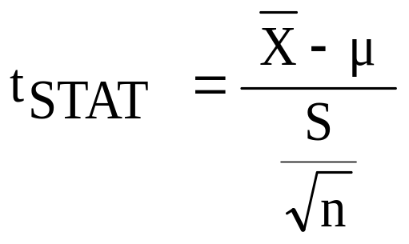
t Test of Hypothesis for the Mean (σ Unknown)
t Test of Hypothesis for the Mean (σ Unknown)
Convert sample statistic ( ) to a t_{STAT} test statistic
X
Hypothesis
Tests for μ
Hypothesis
Tests for μ
Hypothesis
Tests for μ
σ Known
σ Known
σ Known
σ Known
σ Known
σ Known
σ Unknown
σ Unknown
σ Unknown
σ Unknown
σ Unknown
σ Unknown
(Z test)
(Z test)
(Z test)
(t test)
(t test)
(t test)
The test statistic is:
The test statistic is:
The test statistic is:
Basic Business Statistics, 11e © 2009 Prentice-Hall, Inc..
Chap 9-<number>

Slide 39

Example: Two-Tail Test
(σ Unknown)
The average cost of a hotel room in New York is said to be $168 per night. To determine if this is true, a random sample of 25 hotels is taken and resulted in an X of $172.50 and an S of $15.40. Test the appropriate hypotheses at α = 0.05.
(Assume the population distribution is normal)
H₀: μ = 168 H₁: μ ≠ 168
Basic Business Statistics, 11e © 2009 Prentice-Hall, Inc..
Chap 9-<number>

Slide 40
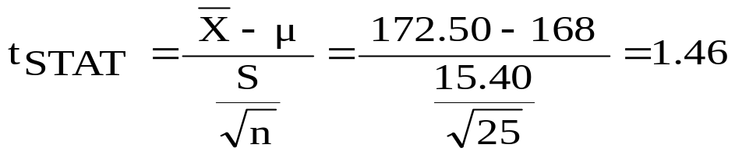
Example Solution:
Two-Tail t Test
H₀: μ = 168 H₁: μ ≠ 168
α/2=.025
α/2=.025
α = 0.05
n = 25, df = 25-1=24
σ is unknown, so
use a t statistic
Critical Value:
±t_{24,0.025} = ± 2.0639
Reject H₀
Do not reject H₀
Reject H₀
-t _{24,0.025}
t _{24,0.025}
0
-2.0639
2.0639
1.46
Do not reject H₀: insufficient evidence that true mean cost is different than $168
Basic Business Statistics, 11e © 2009 Prentice-Hall, Inc..
Chap 9-<number>

Slide 41
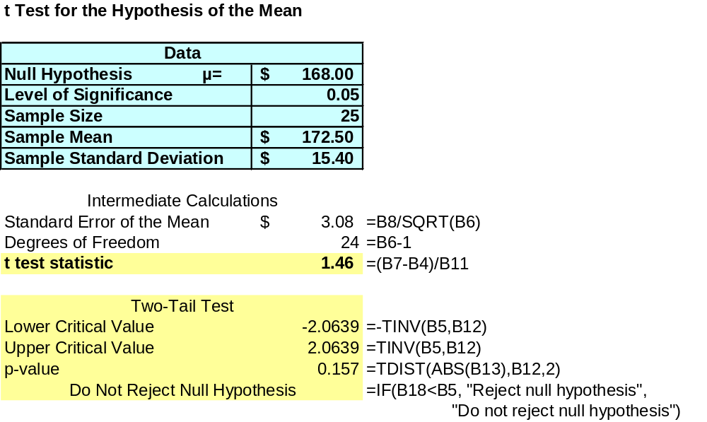
Example Two-Tail t Test Using A p-value from Excel
Since this is a t-test we cannot calculate the p-value without some calculation aid.
The Excel output below does this:
p-value > α
So do not reject H₀
Basic Business Statistics, 11e © 2009 Prentice-Hall, Inc..
Chap 9-<number>

Slide 42
Example Two-Tail t Test Using A p-value from Minitab
One-Sample T
Test of mu = 168 vs not = 168
N Mean StDev SE Mean 95% CI T P
25 172.50 15.40 3.08 (166.14, 178.86) 1.46 0.157
p-value > α
So do not reject H₀

Slide 43


Connection of Two Tail Tests to Confidence Intervals
For X = 172.5, S = 15.40 and n = 25, the 95% confidence interval for µ is:
172.5 - (2.0639) 15.4/ 25 to 172.5 + (2.0639) 15.4/ 25
166.14 ≤ μ ≤ 178.86
Since this interval contains the Hypothesized mean (168), we do not reject the null hypothesis at α = 0.05
Basic Business Statistics, 11e © 2009 Prentice-Hall, Inc..

Slide 44
One-Tail Tests
In many cases, the alternative hypothesis focuses on a particular direction
This is a lower-tail test since the alternative hypothesis is focused on the lower tail below the mean of 3
H₀: μ ≥ 3
H₁: μ < 3
H₀: μ ≤ 3
H₁: μ > 3
This is an upper-tail test since the alternative hypothesis is focused on the upper tail above the mean of 3
Basic Business Statistics, 11e © 2009 Prentice-Hall, Inc..
Chap 9-<number>

Slide 45
Lower-Tail Tests
H₀: μ ≥ 3
H₁: μ < 3
There is only one critical value, since the rejection area is in only one tail
α
Reject H₀
Do not reject H₀
Z or t
-Z_{α} or -t_{α}
0
μ
X
Critical value
Basic Business Statistics, 11e © 2009 Prentice-Hall, Inc..
Chap 9-<number>

Slide 46
Upper-Tail Tests
H₀: μ ≤ 3
H₁: μ > 3
There is only one critical value, since the rejection area is in only one tail
α
Z or t
Do not reject H₀
Reject H₀
0
Z_{α} or t_{α}
_
X
μ
Critical value
Basic Business Statistics, 11e © 2009 Prentice-Hall, Inc..
Chap 9-<number>

Slide 47
Example: Upper-Tail t Test for Mean (σ unknown)
A phone industry manager thinks that customer monthly cell phone bills have increased, and now average over $52 per month. The company wishes to test this claim. (Assume a normal population)
Form hypothesis test:
H₀: μ ≤ 52 the average is not over $52 per month
H₁: μ > 52 the average is greater than $52 per month
(i.e., sufficient evidence exists to support the
manager’s claim)
Basic Business Statistics, 11e © 2009 Prentice-Hall, Inc..
Chap 9-<number>

Slide 48
Example: Find Rejection Region
(continued)
Suppose that α = 0.10 is chosen for this test and n = 25.
Find the rejection region:
Reject H₀
α = 0.10
Do not reject H₀
Reject H₀
0
1.318
Reject H₀ if t_{STAT} > 1.318
Basic Business Statistics, 11e © 2009 Prentice-Hall, Inc..
Chap 9-<number>

Slide 49
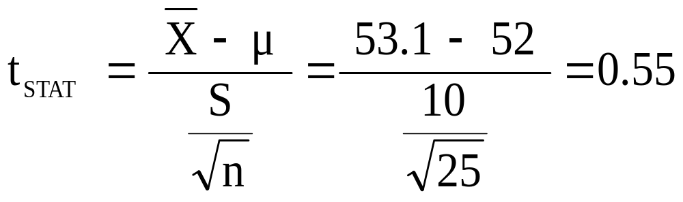
Example: Test Statistic
(continued)
Obtain sample and compute the test statistic
Suppose a sample is taken with the following results: n = 25, X = 53.1, and S = 10
  Then the test statistic is:
Basic Business Statistics, 11e © 2009 Prentice-Hall, Inc..
Chap 9-<number>

Slide 50
Example: Decision
(continued)
Reach a decision and interpret the result:
Reject H₀
α = 0.10
Do not reject H₀
1.318
Reject H₀
0
t_{STAT} = 0.55
Do not reject H₀ since t_{STAT} = 0.55 ≤ 1.318
there is not sufficient evidence that the
mean bill is over $52
Basic Business Statistics, 11e © 2009 Prentice-Hall, Inc..
Chap 9-<number>

Slide 51
Example: Utilizing The p-value for The Test
Calculate the p-value and compare to α (p-value below calculated using excel spreadsheet on next page)
p-value = .2937
Reject H₀
α = .10
0
Do not reject H₀
1.318
Reject H₀
t_{STAT} = .55
Do not reject H₀ since p-value = .2937 > α = .10
Basic Business Statistics, 11e © 2009 Prentice-Hall, Inc..
Chap 9-<number>

Slide 52
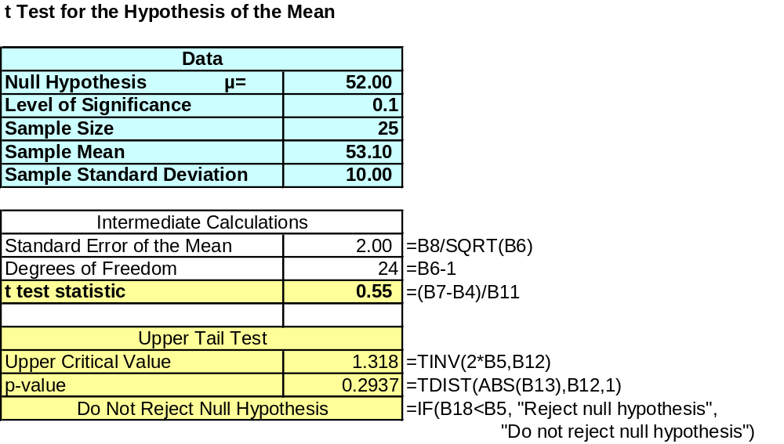
Excel Spreadsheet Calculating The p-value for The Upper Tail t Test
Basic Business Statistics, 11e © 2009 Prentice-Hall, Inc..
Chap 9-<number>

Slide 53
Hypothesis Tests for Proportions
Involves categorical variables
Two possible outcomes
  Possesses characteristic of interest
  Does not possess characteristic of interest
Fraction or proportion of the population in the category of interest is denoted by π
Basic Business Statistics, 11e © 2009 Prentice-Hall, Inc..
Chap 9-<number>

Slide 54
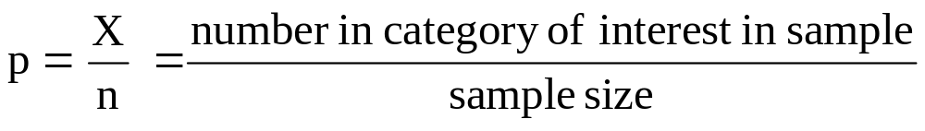
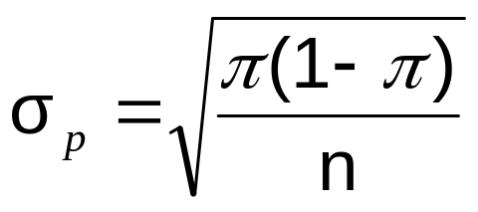
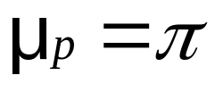
Proportions
(continued)
Sample proportion in the category of interest is denoted by p
When both nπ and n(1-π) are at least 5, p can be approximated by a normal distribution with mean and standard deviation
Basic Business Statistics, 11e © 2009 Prentice-Hall, Inc..
Chap 9-<number>

Slide 55
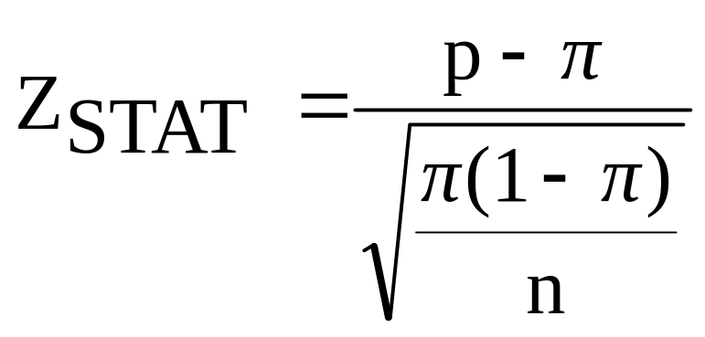
Hypothesis Tests for Proportions
The sampling distribution of p is approximately normal, so the test statistic is a Z_{STAT} value:
Hypothesis
Tests for p
nπ ≥ 5
and
n(1-π) ≥ 5
nπ < 5
or
n(1-π) < 5
Not discussed in this chapter
Basic Business Statistics, 11e © 2009 Prentice-Hall, Inc..
Chap 9-<number>

Slide 56
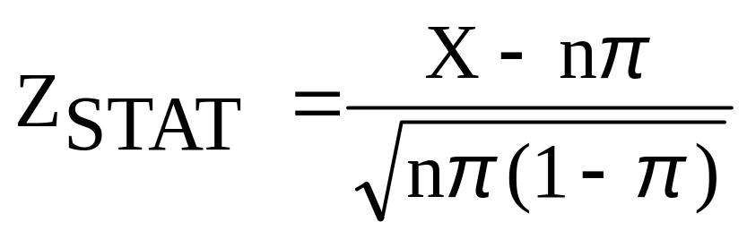
Z Test for Proportion in Terms of Number in Category of Interest
An equivalent form to the last slide, but in terms of the number in the category of interest, X:
Hypothesis
Tests for X
X ≥ 5
and
n-X ≥ 5
X < 5
or
n-X < 5
Not discussed in this chapter
Basic Business Statistics, 11e © 2009 Prentice-Hall, Inc..
Chap 9-<number>

Slide 57

Example: Z Test for Proportion
A marketing company claims that it receives 8% responses from its mailing. To test this claim, a random sample of 500 were surveyed with 25 responses. Test at the α = 0.05 significance level.
Check:
n π = (500)(.08) = 40
n(1-π) = (500)(.92) = 460
✓
Basic Business Statistics, 11e © 2009 Prentice-Hall, Inc..
Chap 9-<number>

Slide 58
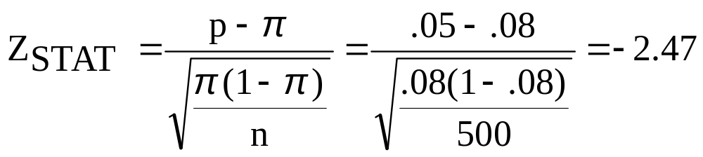
Z Test for Proportion: Solution
Test Statistic:
H₀: π = 0.08 H₁: π ≠ 0.08
α = 0.05
n = 500, p = 0.05
Critical Values: ± 1.96
Decision:
Reject H₀ at α = 0.05
Reject
Reject
Conclusion:
.025
.025
There is sufficient evidence to reject the company’s claim of 8% response rate.
z
-1.96
0
1.96
-2.47
Basic Business Statistics, 11e © 2009 Prentice-Hall, Inc..
Chap 9-<number>

Slide 59
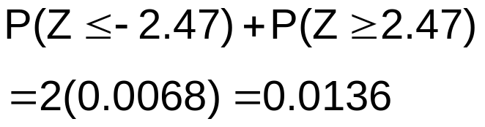
p-Value Solution
(continued)
Calculate the p-value and compare to α
(For a two-tail test the p-value is always two-tail)
Do not reject H₀
Reject H₀
Reject H₀
p-value = 0.0136:
α/2 = .025
α/2 = .025
0.0068
0.0068
-1.96
0
1.96
Z = -2.47
Z = 2.47
Reject H₀ since p-value = 0.0136 < α = 0.05
Basic Business Statistics, 11e © 2009 Prentice-Hall, Inc..
Chap 9-<number>

Slide 60
The Power of a Test
The power of the test is the probability of
correctly rejecting a false H₀
Suppose we correctly reject H₀: μ ≥ 52
when in fact the true mean is μ = 50
Power = 1-β
α
50
52
Reject
H₀: μ ≥ 52
Do not reject
H₀ : μ ≥ 52
Basic Business Statistics, 11e © 2009 Prentice-Hall, Inc..
Chap 9-<number>

Slide 61
Type II Error
Suppose we do not reject H₀: μ ≥ 52 when in fact the true mean is μ = 50
This is the range of X where H₀ is not rejected
This is the true distribution of X if μ = 50
Prob. of type II error = β
50
52
Reject
H₀: μ ≥ 52
Do not reject
H₀ : μ ≥ 52
Basic Business Statistics, 11e © 2009 Prentice-Hall, Inc..
Chap 9-<number>

Slide 62
Type II Error
(continued)
Suppose we do not reject H₀: μ ≥ 52 when in fact the true mean is μ = 50
Here, β = P( X ≥ cutoff ) if μ = 50
α
β
50
52
Reject
H₀: μ ≥ 52
Do not reject
H₀ : μ ≥ 52
Basic Business Statistics, 11e © 2009 Prentice-Hall, Inc..
Chap 9-<number>

Slide 63
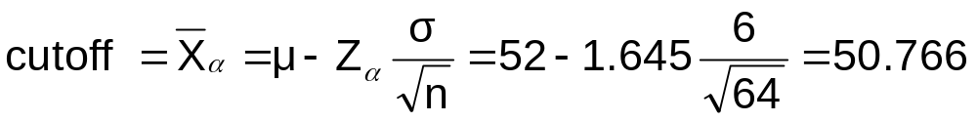
Calculating β
Suppose n = 64 , σ = 6 , and α = .05
(for H₀ : μ ≥ 52)
So β = P( x ≥ 50.766 ) if μ = 50
α
50
50.766
52
Reject
H₀: μ ≥ 52
Do not reject
H₀ : μ ≥ 52
Basic Business Statistics, 11e © 2009 Prentice-Hall, Inc..
Chap 9-<number>

Slide 64
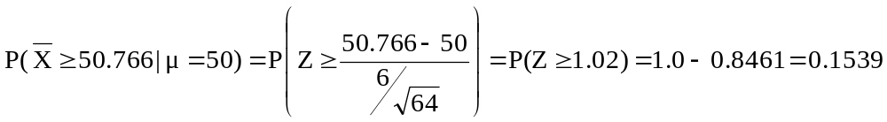
Calculating β and
Power of the test
(continued)
Suppose n = 64 , σ = 6 , and α = 0.05
Power
= 1 - β
= 0.8461
Probability of type II error:
β = 0.1539
The probability of correctly rejecting a false null hypothesis is 0.8641
50
50.766
52
Reject
H₀: μ ≥ 52
Do not reject
H₀ : μ ≥ 52
Basic Business Statistics, 11e © 2009 Prentice-Hall, Inc..
Chap 9-<number>

Slide 65
Power of the Test
Conclusions regarding the power of the test:
  A one-tail test is more powerful than a two-tail test
  An increase in the level of significance (α) results in an increase in power
  An increase in the sample size results in an increase in power
Basic Business Statistics, 11e © 2009 Prentice-Hall, Inc..
Chap 9-<number>

Slide 66
Potential Pitfalls and
Ethical Considerations
Use randomly collected data to reduce selection biases
Do not use human subjects without informed consent
Choose the level of significance, α, and the type of test (one-tail or two-tail) before data collection
Do not employ “data snooping” to choose between one-tail and two-tail test, or to determine the level of significance
Do not practice “data cleansing” to hide observations that do not support a stated hypothesis
Report all pertinent findings including both statistical significance and practical importance
Basic Business Statistics, 11e © 2009 Prentice-Hall, Inc..
Chap 9-<number>

Slide 67
Chapter Summary
Addressed hypothesis testing methodology
Performed Z Test for the mean (σ known)
Discussed critical value and p–value approaches to hypothesis testing
Performed one-tail and two-tail tests
Basic Business Statistics, 11e © 2009 Prentice-Hall, Inc..
Chap 9-<number>

Slide 68
Chapter Summary
(continued)
Performed t test for the mean (σ unknown)
Performed Z test for the proportion
Calculated the probability of a Type II error and the power of the test
Discussed pitfalls and ethical issues
Basic Business Statistics, 11e © 2009 Prentice-Hall, Inc..
Chap 9-<number>

